Slide 1

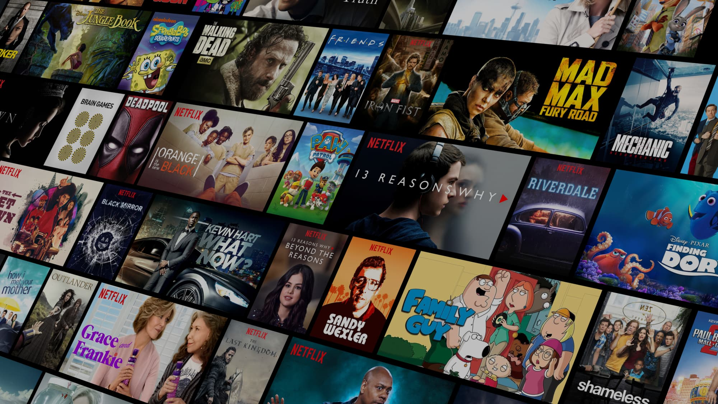

MOVIE RECOMMENDATION SYSTEM
Team Members
Diya Gupta
Akanksha Tanneeru
Aylin Isidoro Cordova
Ibrahim Khan

Slide 2
Problem addressed: Users face the “paradox of choice” on streaming platforms — too many movies, difficult to decide.
Problem Definition: Build a Content-based recommendation system recommends movies based on similarity in movie metadata.
Motivation: Help users quickly discover relevant movies based on their interests.
Applications:
Streaming platforms (Netflix, Amazon Prime, Hotstar)
Personalized entertainment platforms
BACKGROUND
Notes:
Diya
- In this project, we are addressing the paradox of choice that users face on deciding which movie they really want to watch. With too many movie options, it becomes difficult for them to decide.
- Therefore we’ve built a content-based recommendation system that recommends movies based on similarity in movie metadata.
This system will help users to quickly discover relevant movies based on their interests.
Recommendation systems have been used as streaming platforms such as Netflix, amazon prime video which act as personalized entertainment platform.

Slide 3
Real-time evaluation of recommendations:our system integrates NDCG evaluation inside the recommendation pipeline to quantitatively validate ranking performance and improve transparency
Conversational search support:our system understands free-text movie descriptions, enabling flexible natural-language-based discovery.
Fully content-based:does not rely on user history or ratings, making it suitable for cold-start users with no profile data.
Features of Recommendation
System
Notes:
Diya
Coming on to the features of this recommendation system:
this system evaluates the recommendations in real-time using NDCG evaluation metric. It quantitatively validates the ranking performance and improves transparency
It supports conversational search which means that users can enter a description of a movie they want to watch and the system will show similar results which makes the system flexible to user query
This system is fully content based. It does not rely on user history or ratings which makes it suitable for cold-start users with no profile data.

Slide 4
DATA DESCRIPTION
Data collection source: Kaggle TMDB dataset (The movie database)
Number of movies Used: 4803 movies
Data Filtering: Has 20 data columns, which were reduced 5 meaningful data columns: movie_id, title, overview, genre, keywords, cast and crew.
Combining metadata: Create a combined field tags to unify all textual metadata.
Issues encountered while filtering data:
Missing poster images
Null/empty values in metadata
Inconsistent formatting of text fields
Notes:
Aylin

Slide 5
ARCHITECTURE OVERVIEW
NDCG Evaluation @K
Compute relevance and ranking
Validate result Ordering
Final output
(UI implementation)
Ranked Movies + posters returned
Data Preprocessing
(Tokenization,
Lemmatization,
Stemming )
TF-IDF Vectorizer
(Create text vectors)
Cosine Similarity
(Calculate movie similarity scores )
Notes:
Aylin-explain the slide briefly

Slide 6
STEP-1 DATA PREPROCESSING
STEP | DESCRIPTION
Tokenization | Combined useful text fields into tags column
Lemmatization | Converted words to base form to reduce variation (actors’ -> ‘actor)
Stemming | Normalized words to root form(Love, loving, loved-> ‘lov’)
TF-IDF vectorization | Transformed the text into numerical vectors
Cosine Similarity | Calculate numeric similarity score between movies
Notes:
Diya
The first stage is the data preprocessing stage which consists of 5 steps:
Tokenisation: after filtering the data , we combined the useful text fields into a column named tags
Lemmatization: in order to reduce variation, we have converted the text to base form. This reduces vocabulary size and avoids treating similar words as separate terms.
Stemming: We applied stemming to reduce words to their root form, such as ‘loved’, ‘loving’, and ‘love’ all becoming ‘lov’. This improves match strength and increases similarity accuracy.
TF-IDF vectorisation: We then transformed the text into numerical vectors using TF-IDF, which gives higher weight to meaningful words and lower weight to very common words.
Cosine Similarity: Calculate numeric similarity score between movies that shows how close two movies are in vector space. Values closer to 1 mean higher similarity.

Slide 7
Movie-Based Recommendation Function
User selects a movie title → system finds its index in the dataset
Computes similarity score between the selected movie and all others
Sorts and returns Top-5 most similar movies
b. Conversational / Description-Based Recommendation
Accepts user input describing a movie (e.g., “science fiction space adventure”)
Converts the input to TF-IDF vector and calculates cosine similarity with all movies
Returns Top-5 movies matching the description
STEP 2.
RECOMMENDATION
ENGINE
Notes:
Akanksha

Slide 8
Metrics: NDCG@K (Normalized Discounted Cumulative Gain)
After generating recommendations, the system computes tag-based relevance scores and calculates NDCG, which tells us how well our ranking aligns with the expected ideal relevance order.
This helps us test the quality of our recommendation algorithm objectively and adjust parameters without affecting the user interface.
NDCG values close to 1 showed that our system outputs highly relevant and properly ranked results
Advantages of using NDCG@K:
ensures ranking quality, not just item similarity
Helps compare performance across different query types
STEP 3.
EVALUATION
Notes:
Diya
To evaluate recommendations, we have used Normalised discounted cumulative gain also called as NDCG
It evaluates not just the recommendations but also they appear in correct order of importance
After generating recommendations, the system computes tag-based relevance scores and calculates NDCG, which tells us how well our ranking aligns with the expected ideal relevance order.
This allows us to objectively test and validate the quality of our recommendation algorithm without impacting the UI design
NDCG values close to 1 showed that our system outputs highly relevant and properly ranked result
We used NDCG because it ensures ranking quality, not just simarity and helps compare performance across different query types

Slide 9
Tools & Libraries Used:
Streamlit – Primary framework for building the interactive web UI
HTML & CSS (inside Streamlit) – For custom styling and layout corrections
Python – Backend logic for recommendations
Pandas / NumPy / Scikit-Learn – Connecting UI with ML model output
STEP-4
UI
IMPLEMENTATION
Notes:
Akanksha

Slide 10
User Input:
Movie input queries (e.g., Inception, Avatar, etc.)
Natural-language description queries (e.g., “thriller with crime investigation”)
Observation
Content-based method returned contextually relevant recommendations
Conversational search performed well for generalized queries
Nature of results obtained:
Title-based recommendations showed highest consistency
Conversational search performed well even without user history
Returned recommendations were highly relevant and correctly ranked
EXPERIMENTS
AND
RESULTS
Notes:
Akanksha

Slide 11
Baseline Comparison
Baseline Method | Our system
Simple keyword matching | TF-IDF weighted vector representation
No ranking validation | Cosine similarity ranking
Weak relevance | NDCG-validated ordering
Poor context understanding | Handles real-language search queries
EXPERIMENTS
AND
RESULTS
Discussion of Results
Accuracy: relevance of results confirmed through NDCG evaluation
Efficiency: Fast performance due to pre-computed cosine similarity matrix
Scalability: Suitable for medium datasets
Limitations: lacks diversity for niche movies, limited to size of the dataset
Notes:
Diya
To understand how ell our system performs, we have used a baseline approach.
The baseline method such as simple keyword matching returns weak or irrelevant results so we have used TF-IDF weighted vector representation
Ranking is done based on cosine simalrity
Baseline methods cannot measure the ranking quality hence we have used NDCG ranking
This system not only understands keywords but also natural language
To summarise the results:
The system generates relevant recommendations which is confirmed thru NDCG ranking
It is efficient as it uses pre computed cosine similarity matrix
It is suitable for medium dataset
However lacks diversity for niche movies and is limited to the size of dataset as here we have used only around 4k movies

Slide 12
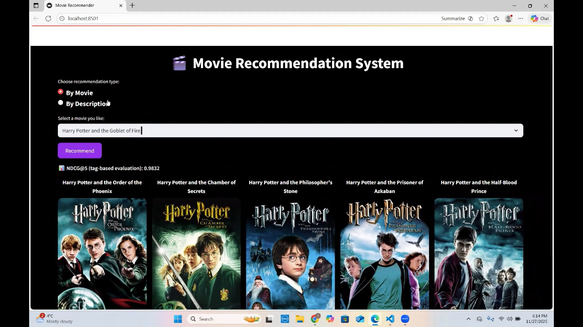
PROJECT DEMO (VIDEO)
Notes:
Aylin

Slide 13
CONCLUSION
Built a working content-based movie recommendation system using TF-IDF & cosine similarity
Added NDCG evaluation for ranking quality validation
Strengths:
Simple, fast, scalable for real systems
Accurate recommendations for popular movies & descriptive text queries
Limitations:
Depends only on metadata
Cannot capture user preferences or emotional sentiments
Notes:
Akanksha

Slide 14
Hybrid model with collaborative filtering
Add sentiment analysis of reviews
Improve conversational search with real NLP models
FUTURE WORK
Notes:
Aylin

Slide 15
Thank You

